Slide 1




Network Sniffing
Tbilisi, 2022

Slide 2

Overview
Wireshark
Forensics
Machine: online-encryption

Slide 3

Terms & Conditions
For Educational Purposes Only
In either case,
hacking without a customer’s explicit permission and direction
is a crime.

Slide 4
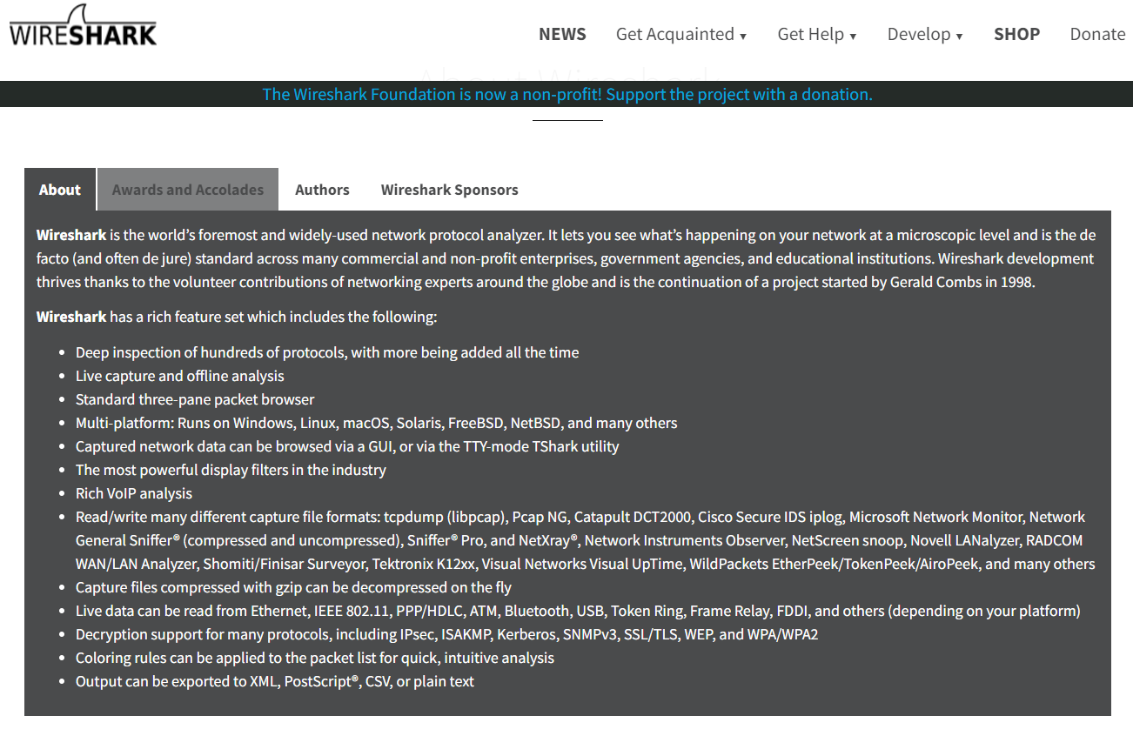
wireshark.org

Slide 5

Practice on Wireshark File

Slide 6
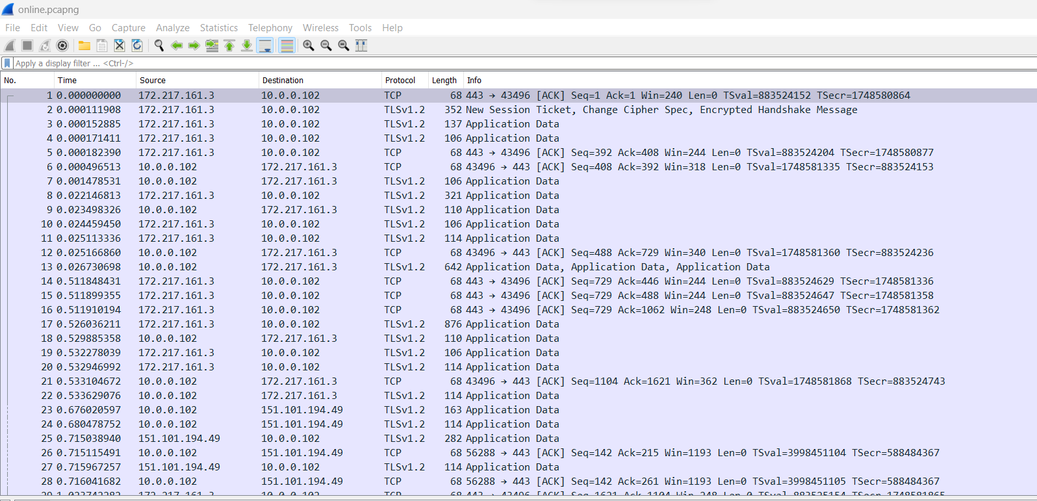
Laboratory: online-encryption
Description:
This is why you should not trust online encryption for your most awesome secrets.
Flag format: CTF{sha256}
Level: Easy
Server: 34.107.45.207:31871
Hints:
Hint 1: Network Sniffing

Slide 7
Laboratory: online-encryption
???

Slide 8
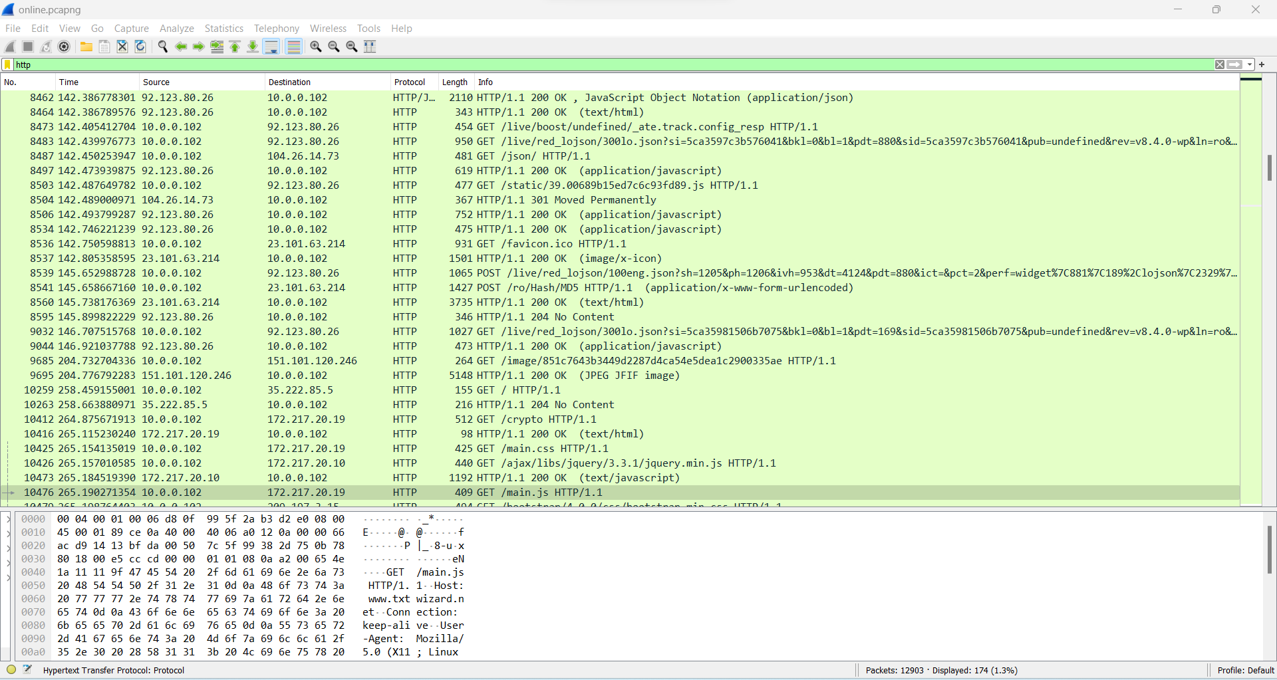
Laboratory: online-encryption
Search for traffic using http filter

Slide 9
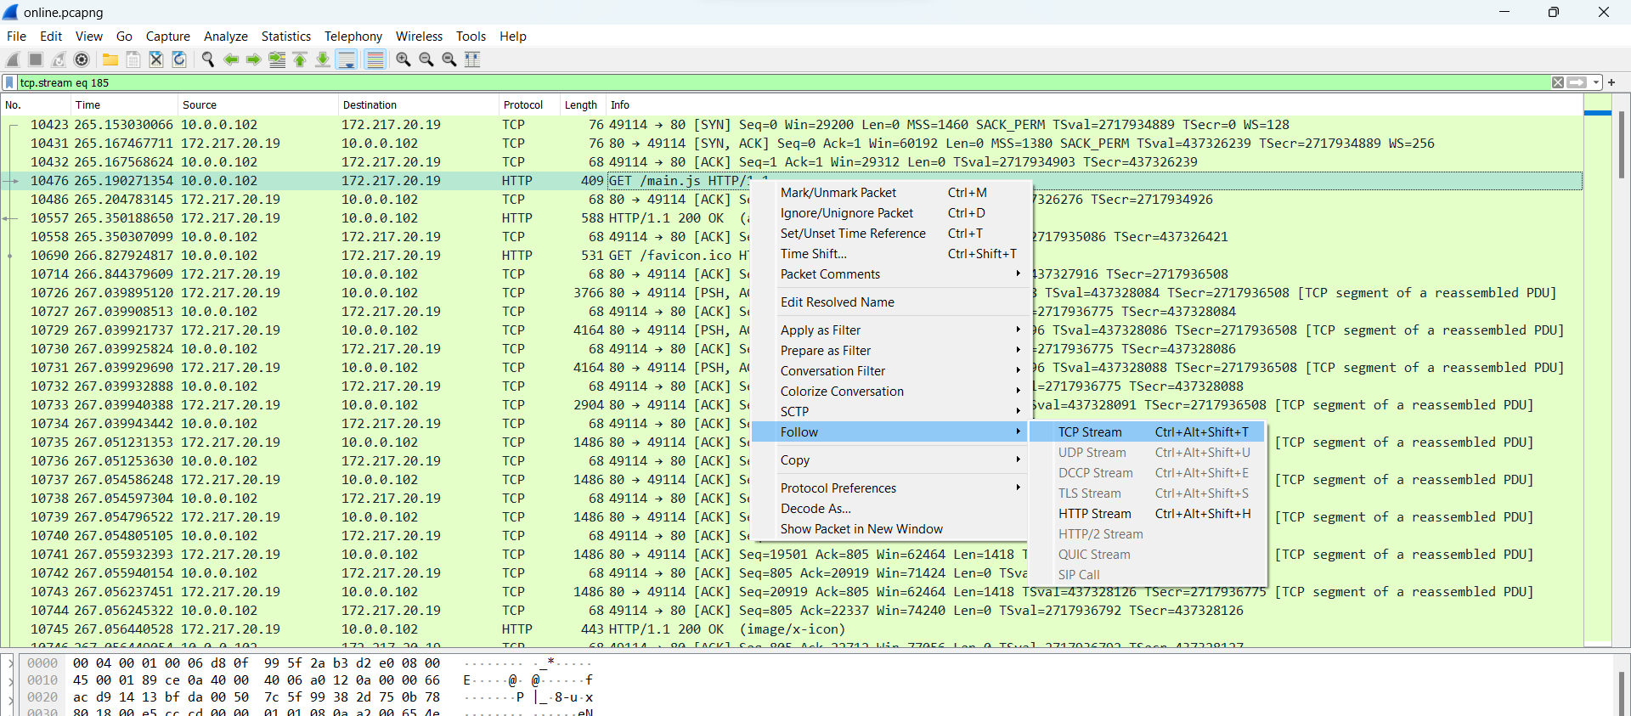
Laboratory: online-encryption
Search for traffic using http filter. Follow the HTTP stream with the shortcut Ctrl+Alt+Shift+H

Slide 10
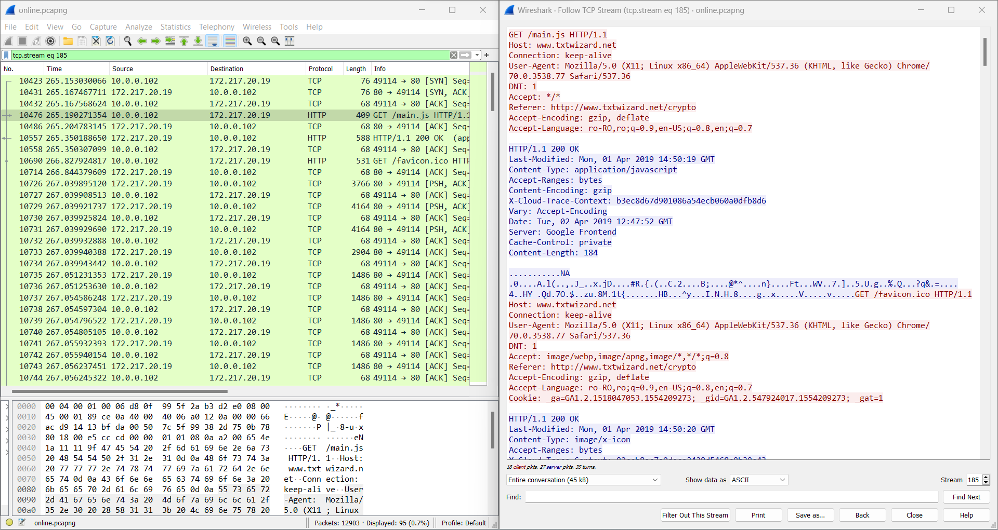
Laboratory: online-encryption
Eventually we can spot suspicious traffic to www.txtwizard.net

Slide 11
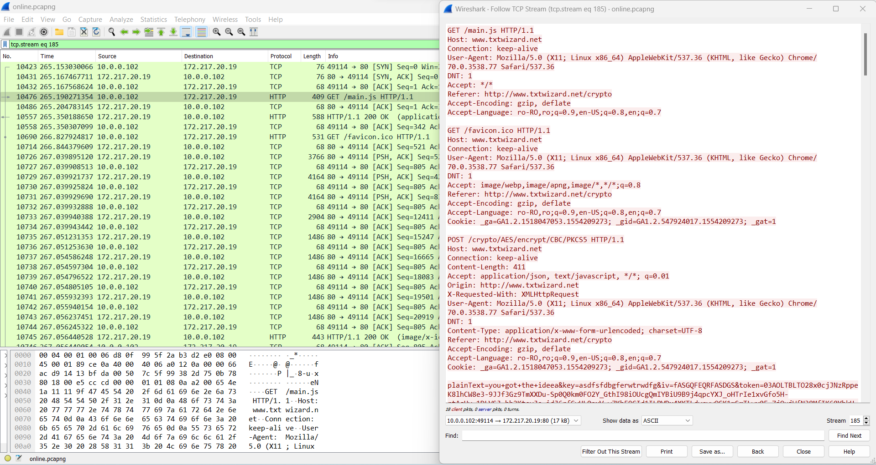
Laboratory: online-encryption
Select to follow the conversation from the client only.
Looking at the traffic we can note suspicious plainText argument sent from the client to the
server.

Slide 12
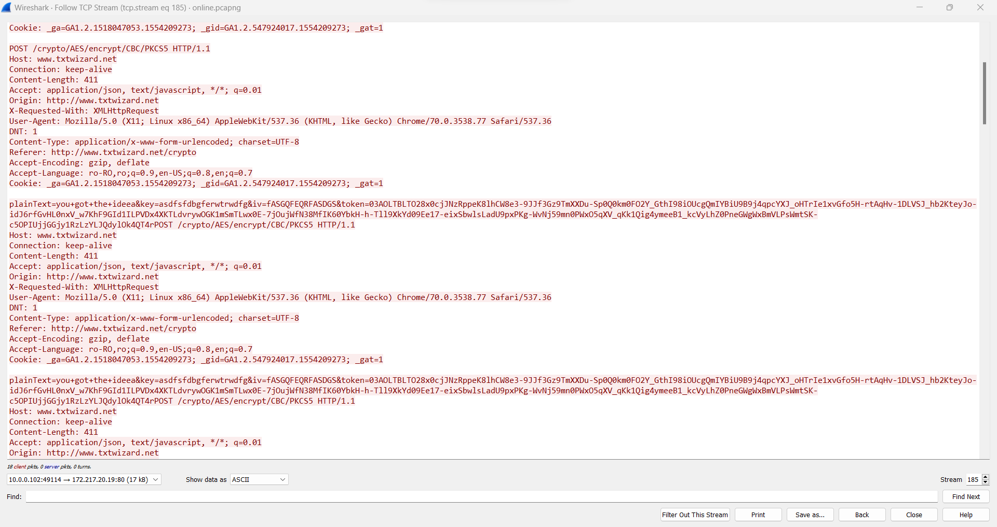
Laboratory: online-encryption
Now we can copy the messages and filter them with regexes in a text edition with an engine
implemented to get only the plainText argument values.

Slide 13
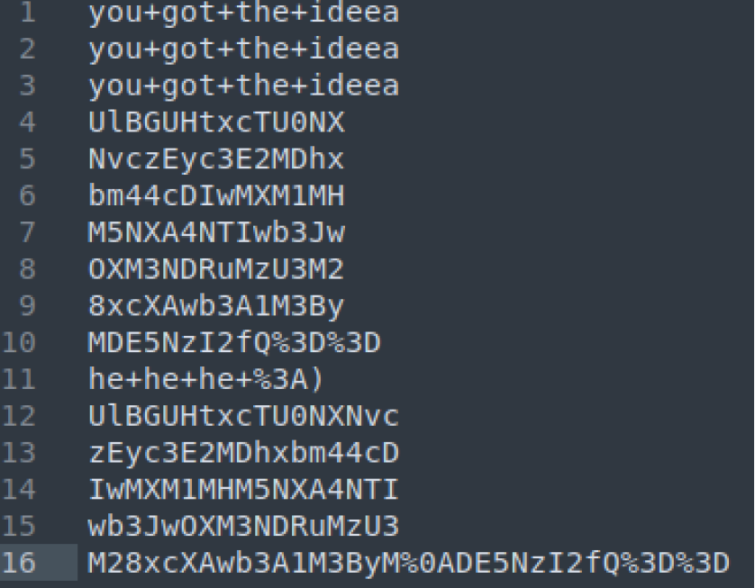
Laboratory: online-encryption
Resulting in:
An example regex is:
plainText=(.*?)&key
Notes:
UlBGUHtxcTU0NX
NvczEyc3E2MDhx
bm44cDIwMXM1MH
M5NXA4NTIwb3Jw
OXM3NDRuMzU3M2
8xcXAwb3A1M3By
MDE5NzI2fQ%3D%3D
UlBGUHtxcTU0NXNvc
zEyc3E2MDhxbm44cD
IwMXM1MHM5NXA4NTI
wb3JwOXM3NDRuMzU3
M28xcXAwb3A1M3ByM%0ADE5NzI2fQ%3D%3D
UlBGUHtxcTU0NX
NvczEyc3E2MDhx
bm44cDIwMXM1MH
M5NXA4NTIwb3Jw
OXM3NDRuMzU3M2
8xcXAwb3A1M3By
MDE5NzI2fQ
UlBGUHtxcTU0NXNvc
zEyc3E2MDhxbm44cD
IwMXM1MHM5NXA4NTI
wb3JwOXM3NDRuMzU3
M28xcXAwb3A1M3ByM%0ADE5NzI2fQ==
RPFP{qq545sos12sq608qnn8p201s50s95p8520orp9s744n3573o1qp0op53pr019726}
rot13
ECSC{dd545fbf12fd608daa8c201f50f95c8520bec9f744a3573b1dc0bc53ce019726}

Slide 14
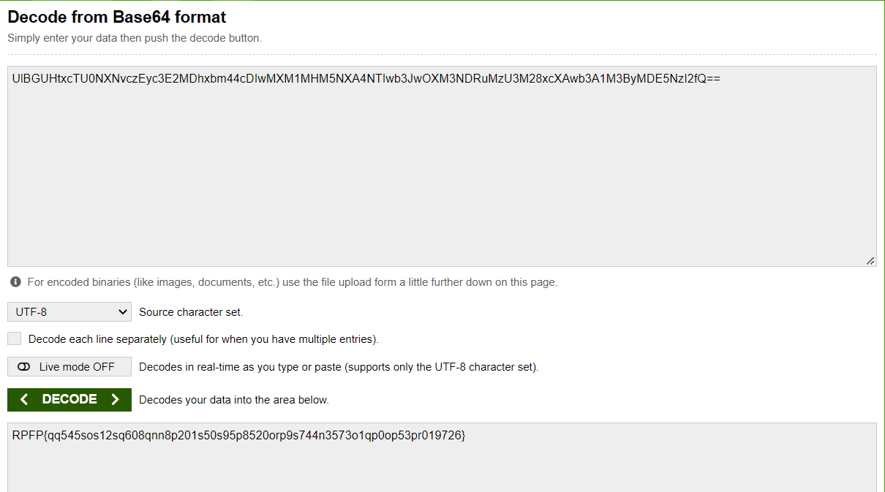
Laboratory: online-encryption
Resulting in:
https://base64decode.org/
Notes:
UlBGUHtxcTU0NX
NvczEyc3E2MDhx
bm44cDIwMXM1MH
M5NXA4NTIwb3Jw
OXM3NDRuMzU3M2
8xcXAwb3A1M3By
MDE5NzI2fQ%3D%3D
UlBGUHtxcTU0NXNvc
zEyc3E2MDhxbm44cD
IwMXM1MHM5NXA4NTI
wb3JwOXM3NDRuMzU3
M28xcXAwb3A1M3ByM%0ADE5NzI2fQ%3D%3D
UlBGUHtxcTU0NX
NvczEyc3E2MDhx
bm44cDIwMXM1MH
M5NXA4NTIwb3Jw
OXM3NDRuMzU3M2
8xcXAwb3A1M3By
MDE5NzI2fQ
UlBGUHtxcTU0NXNvc
zEyc3E2MDhxbm44cD
IwMXM1MHM5NXA4NTI
wb3JwOXM3NDRuMzU3
M28xcXAwb3A1M3ByM%0ADE5NzI2fQ==
RPFP{qq545sos12sq608qnn8p201s50s95p8520orp9s744n3573o1qp0op53pr019726}
rot13
ECSC{dd545fbf12fd608daa8c201f50f95c8520bec9f744a3573b1dc0bc53ce019726}

Slide 15
Laboratory: online-encryption
RPFP{qq545sos12sq608qnn8p201s50s95p8520orp9s744n3573o1qp0op53pr019726}
???
Notes:
UlBGUHtxcTU0NX
NvczEyc3E2MDhx
bm44cDIwMXM1MH
M5NXA4NTIwb3Jw
OXM3NDRuMzU3M2
8xcXAwb3A1M3By
MDE5NzI2fQ%3D%3D
UlBGUHtxcTU0NXNvc
zEyc3E2MDhxbm44cD
IwMXM1MHM5NXA4NTI
wb3JwOXM3NDRuMzU3
M28xcXAwb3A1M3ByM%0ADE5NzI2fQ%3D%3D
UlBGUHtxcTU0NX
NvczEyc3E2MDhx
bm44cDIwMXM1MH
M5NXA4NTIwb3Jw
OXM3NDRuMzU3M2
8xcXAwb3A1M3By
MDE5NzI2fQ
UlBGUHtxcTU0NXNvc
zEyc3E2MDhxbm44cD
IwMXM1MHM5NXA4NTI
wb3JwOXM3NDRuMzU3
M28xcXAwb3A1M3ByM%0ADE5NzI2fQ==
RPFP{qq545sos12sq608qnn8p201s50s95p8520orp9s744n3573o1qp0op53pr019726}
rot13
ECSC{dd545fbf12fd608daa8c201f50f95c8520bec9f744a3573b1dc0bc53ce019726}

Slide 16
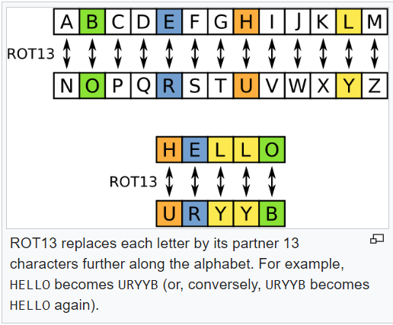
Laboratory: online-encryption
Resulting in:
ROT13 ("rotate by 13 places", sometimes hyphenated ROT-13) is a simple letter substitution cipher that replaces a letter with the 13th letter after it in the alphabet. ROT13 is a special case of the Caesar cipher which was developed in ancient Rome.
After we convert from base64, we can observe that the new text seems to be obfuscated with: rot13
Notes:
RPFP{qq545sos12sq608qnn8p201s50s95p8520orp9s744n3573o1qp0op53pr019726}
rot13
ECSC{dd545fbf12fd608daa8c201f50f95c8520bec9f744a3573b1dc0bc53ce019726}

Slide 17
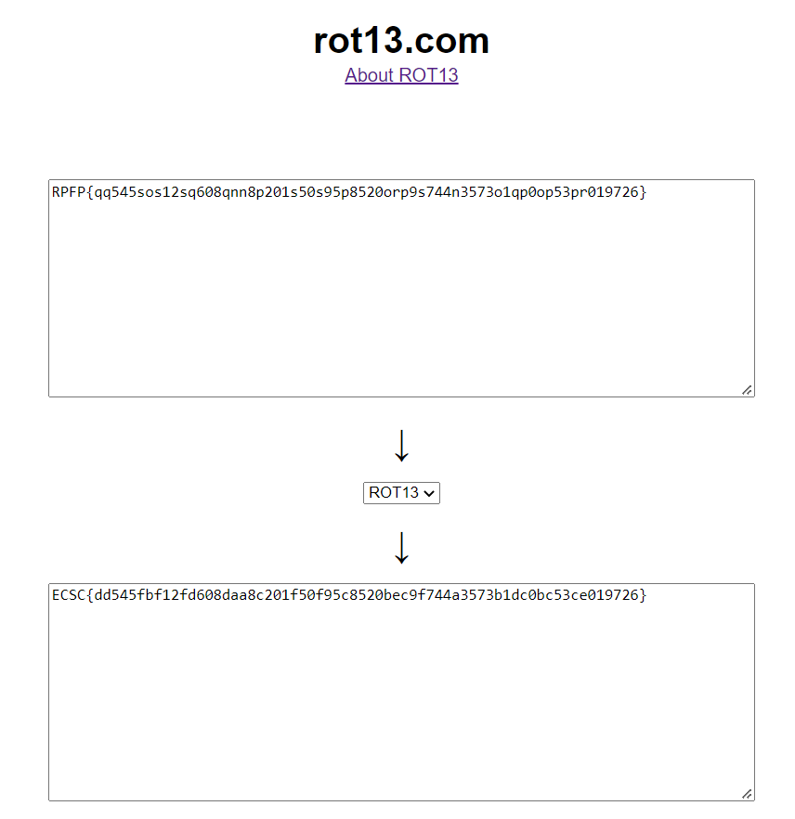
Laboratory: online-encryption
Resulting in:
Notes:
RPFP{qq545sos12sq608qnn8p201s50s95p8520orp9s744n3573o1qp0op53pr019726}
rot13
ECSC{dd545fbf12fd608daa8c201f50f95c8520bec9f744a3573b1dc0bc53ce019726}

